Slide 1
Test Document (IEEE 829)
Test Plan
Test Design Specification
Test Report

Slide 2
Test Plan (STP)
1. Test Plan id 9. Test deliverables
2. Introduction 10 Test task
3 Test items 11 Environmental needs
4 Features to be tested 12 Responsibilities
5 Features not to be tested 13 staffing and training
6 Approach 14 Schedules
7 pass/fail criteria 15 Risks and contingencies
8 suspension and resumption 16 approvals

Slide 3
Test Design Specification (STD)
Test Design Specification
Test Case Specification
Test Procedure Specification

Slide 4
Test Design specification
Test Design spec. ID
features to be tested
approach refinements
Test case ID
pass/fail criteria

Slide 5
Test Case Specification
Test case spec ID
test items
input spec
output spec
environmental needs
special procedural req (ref. Proc. spec)
inter-case dependencies

Slide 6
Test procedure specification
Test procedure spec id
purpose
special requirements
procedure steps

Slide 7
Test Report
Test-item transmittal report
Test Log
Test incident Report
Test summary Report

Slide 8
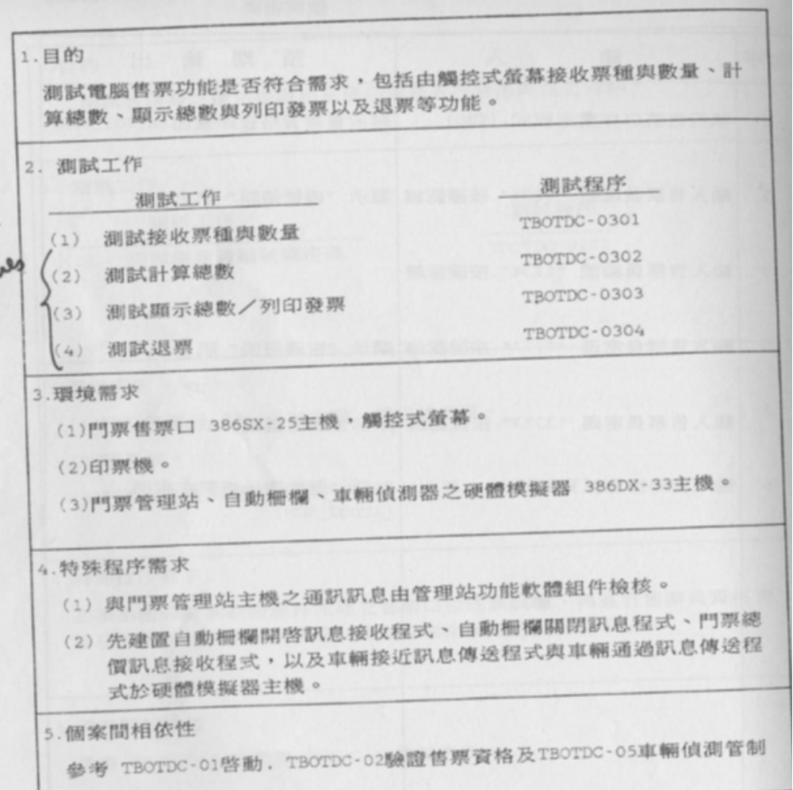
Test Case
purpose
testing procedure
Testing tasks
Environment
requirements
Special requirements
Dependency
among test cases

Slide 9
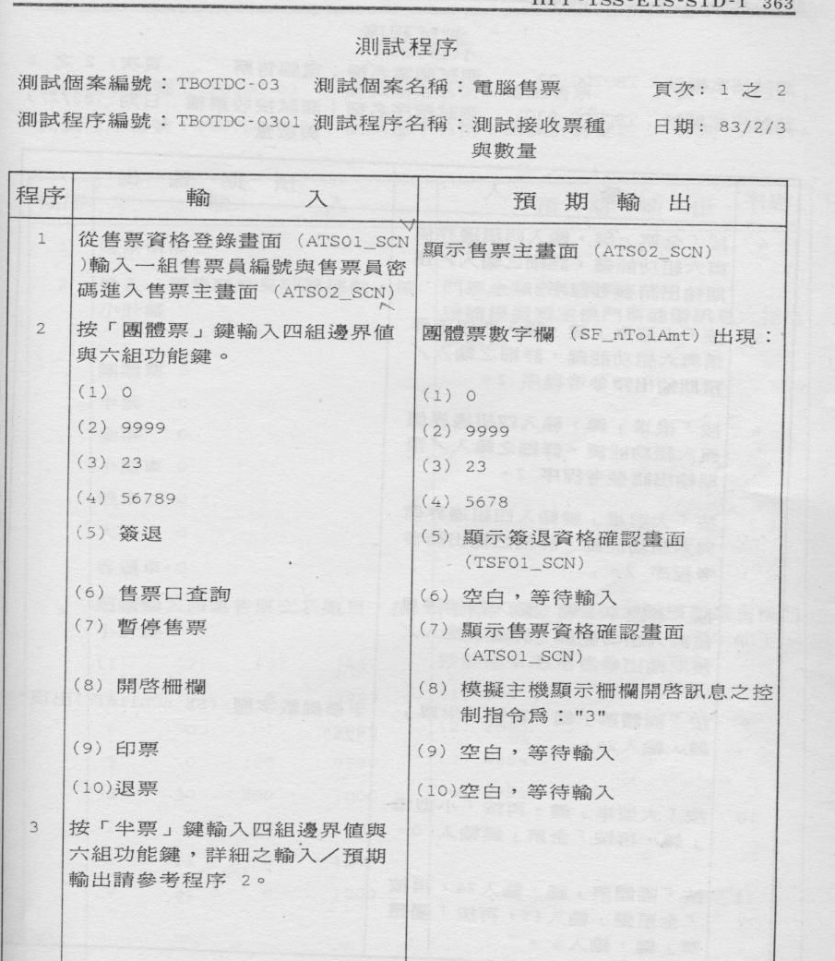
Test Procedure
Test procedure
Test case ID
Test case name
Test procedure ID
Test procedure Name
procedure
input
Expected output

Slide 10
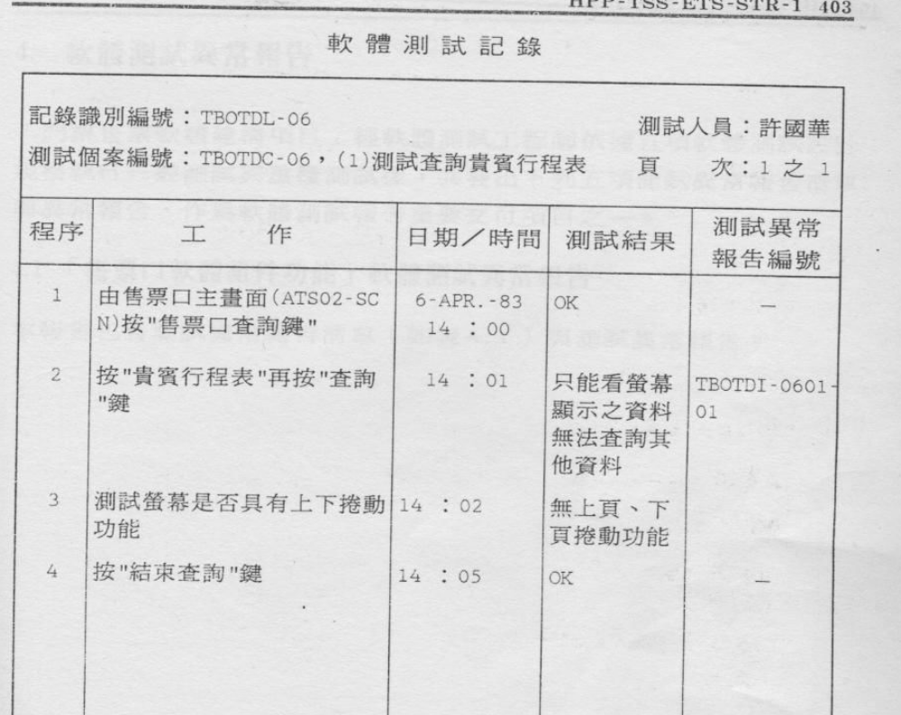
Test log
Log id
Test case id
procedure
task
Date/time
Test result
Abnormality report ID

Slide 11
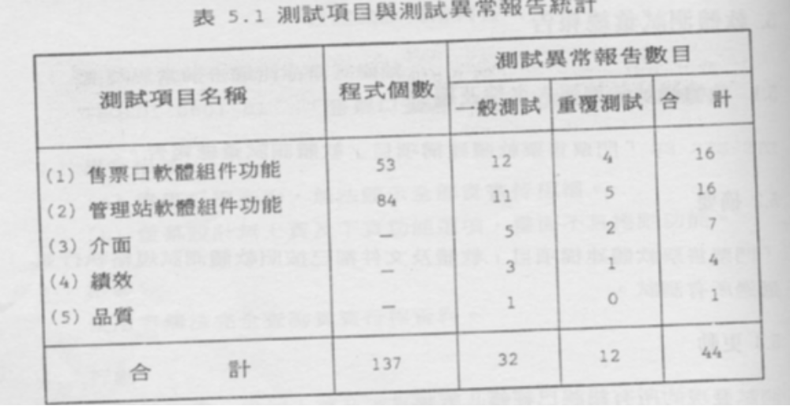
Test report (statistics)
Test statistics
abnormality numbers
Test item names
Program numbers
general tests
Regression tests
total
total

Slide 12
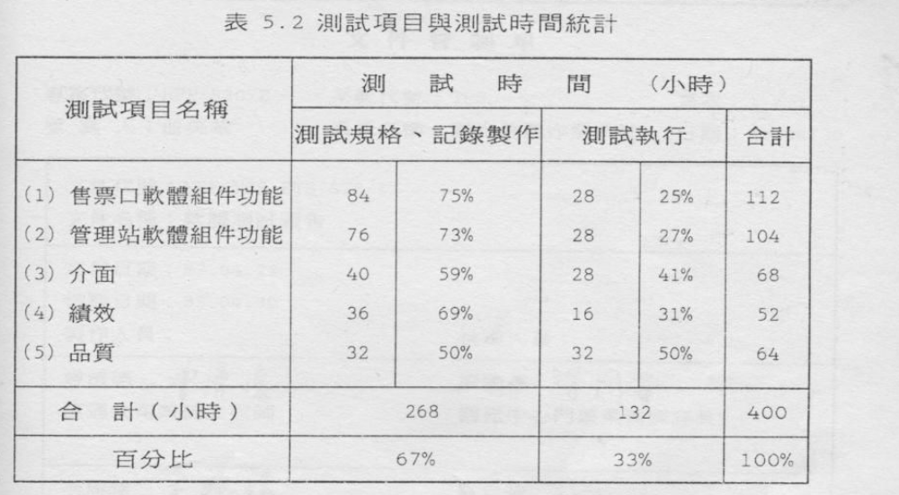
Test report (statistics)
Test items and time statistics
Test time (hours)
Test item names
total
Spec, recording
Test execution
total
percentage

